Slide 1


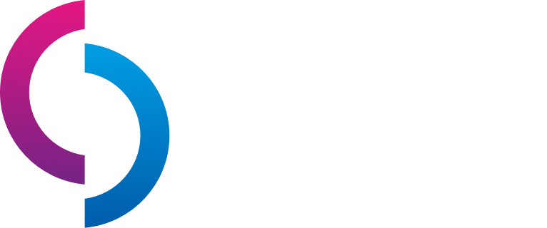

cdc.dev
A Top-Notch tech conference right in the middle of paradise!
@caribbeandevconf

Slide 2






Azure Event Hubs The Architect's Cut
Clemens Vasters
Microsoft Corporation
Chief Messenger
@clemensv
https://github.com/clemensv/messaging

Slide 3
Agenda
A very brief overview: “What is Azure Event Hubs?”
The Event Hubs Deep Dive
Clusters and Namespaces
Networking Capabilities
Authorization Models
Partitions and Log Storage
Message Broker Compute Model
Federation and Replication
Throughput and Latency
Observed Availability and Reliability
Q&A

Slide 4
What is Azure Event Hubs?
Platform-as-a-Service Event Stream Broker
Use the Apache Kafka® API, but with far lower cost and better performance.
Fully managed: You use the features, Azure deals with everything else
AMQP 1.0 standards compliant, Apache Kafka® wire-compatible
Polyglot Azure SDK and cross-platform client support
Industry-leading reliability and availability
Fast.

Slide 5
Azure Event Hubs vs. Apache Kafka®
Similar yet very different
 | Azure Event Hubs | Apache Kafka
User Model | Partitioned event stream broker with high-availability replication | Partitioned event stream broker with high-availability replication
Architecture | Multi-tenant, 3-Tier Gateway/Broker/Storage cluster model, with tenant-isolation, all tiers independently scalable | Single-tenant monolith. Need to increase broker instances in a cluster to scale any dimension.
Implementation Language | C# and Native (C/C++) | Java
Cluster Manager | Azure Service Fabric (inline) | Apache Zookeeper (external); KRaft (inline, experimental)
Partition Mapping | Key hashing, client or server-side mapping of events | Key hashing, client-side mapping of events
Consumer Partition Ownership Coordination | Server-coordinated partition ownership (Kafka), client-coordinated ownership with external leader election. Parallel, direct partition reads. | Server-coordinated partition ownership
Server Workload Balancing | Dynamic and fully automated (100% hands-off). Broker resource allocation independent of partition count or ownership, flexible scaling. | Static assignment of partitions to broker instances requiring operator intervention for rebalancing.
Storage Model | Replicated log store, synchronous per-message flush-to-disk on all replicas | Replicated log store, asynchronous flush-to-disk controlled by host file system write cache settings.
Networking | Single endpoint access to all partitions, Public IP/DNS or Virtual Networking, Firewall. | Endpoint per broker instance. Multiple IPs required. Complex network management required.
Access Control | Token-based access policy model with unlimited publisher policies, Azure Active Directory role-based access control | Local accounts, federation extensibility.
Protocols | AMQP 1.0 (optional: WebSockets) HTTPS 1.1 Apache Kafka RPC | Apache Kafka RPC
Batching / Archives | Avro-packaged batch-packaging and archival to blob store
Schema Registry | Schema Registry based on open CNCF Schema Registry API | (Proprietary from commercial vendors)

Slide 6
SKUs and Pricing
Azure Event Hubs Standard: Shared-resources model
Blended capacity and consumption-based pricing.
Up to 40 MB/sec ingress:
Throughput Units: 1TU = min(1000 msg/s, 1MB/s in), min(2000 msg/s, 2MB/s out)
Capture
First 12M events free, 12-25M $x/1M, 25-50M $x/1M, 50+ $x/1M
Azure Event Hubs Premium: Isolated-resources model
Capacity-based pricing model. No consumption charges.
Up to 120 MB/sec ingress:
Premium Units: 1PU = ~5-10MB/sec throughput, no per-event charge, includes Capture
Azure Event Hubs Dedicated: Dedicated-resources model
Capacity-based pricing model. No consumption charges. Full isolated cluster.
Beyond 120MB/sec ingress (>4 GB/sec in prod)
Capacity Unit: 1CU $4995/mo.
8CU required for availbility zones.
We will discuss all these versions today and what the units mean

Slide 7


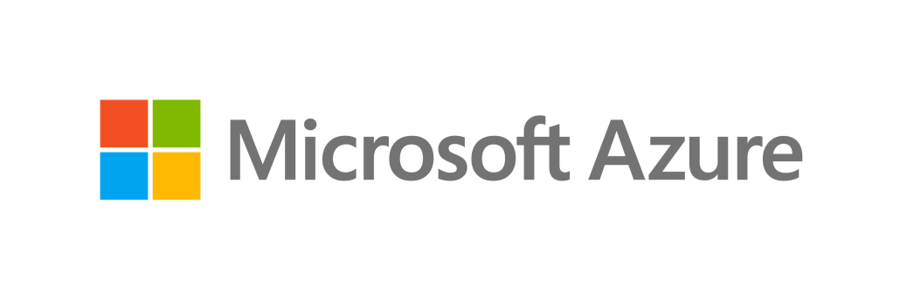
You're running Apache Kafka® in your own datacenter?
Azure Event Hubs
Azure Event Hubs is
more reliable and dependable with higher 24/365 uptime (no service windows or weekend downtime)
far less costly to own (no initial/recurring licensing fees as with commercial Kafka distributions)
far less costly to operate (fully managed, no hardware)
just a quick network hop away from your existing workloads
easy to integrate into your network via VPN Gateway or Express Route

Slide 8
Event Hubs Namespaces: Virtual Brokers
Public IP
Vnet
A
Vnet
B1
Vnet
B2
DNS
Networking
Event Hubs Platform Host (Event Hubs Dedicated is one host cluster)
Firewall with IP Filters
Firewall
yournamespace [.servicebus.windows.net]
othernamespace [.servicebus.windows.net]
Partitions
orders
1
xyz
2
invoices
3
Consumer Groups
abc
4
deliveries
5
klm
production
6
bmg
Azure Resource Manager

Slide 9

Event Hubs
A consumer group is an optional mechanism to allow multiple parallel consumers to coordinate who owns which partition.
Kafka RPC: Broker assigns partitions and checkpoints can be stored in the CG.
AMQP: Clients choose leader using an external mechanism and can break leases using an epoch model. Checkpoints are external. AMQP with server-assigned partitions and CG checkpoints on roadmap.
A log partition is a durable, triple-replicated, append-only storage structure. Each partition has a throughput ceiling imposed by IO and compute limits. More partitions provide more throughput capacity, but also make consumption more complex.
Consumer Group 1
Consumer Group 2
Producers send using a protocol of their choosing, with or without setting a partition key. Partitions can also be targeted directly.
Partition 1
Consumer 1
Consumers on a consumer group own one or more partitions exclusively to ensure in-order processing.
Partition 2
Producer
Event Hub
Consumer 2
Partition 3
Consumers choose the initial log offset: Start (oldest), End (newest), Timestamp, Sequence Number Read progress is noted in checkpoints that can be stored anywhere.
Partition 4
Producers choose their preferred protocol
OASIS AMQP 1.0 Apache Kafka® RPC
HTTPS 1.1
An Event Hub is an event stream manager handling one or more independent log partitions. Different from Apache Kafka®, Event Hubs can optionally assign events to partitions on the server-side.
Consumers choose their own preferred protocol
OASIS AMQP 1.0 Apache Kafka® RPC

Slide 10
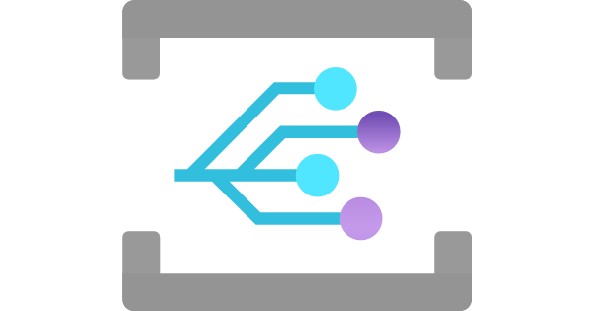

Event Hubs Capture
{Namespace}/{EventHub}/{PartitionId}/{Year}/{Month}/{Day}/{Hour}/{Minute}/{Second}
https://mystorageaccount.blob.core.windows.net/mycontainer/ mynamespace/myeventhub/0/2017/12/08/03/03/17.avro
Event Hubs Capture allows organizing torrents of telemetry in batches that can be easily consumed by batch-oriented analytics frameworks.
Azure Blob Storage
Event is raised when capture file has been written
Lifecycle Policy Automation
Partition 0
Event Hubs Capture Engine
…/myeventhub/0/…
…/myeventhub/1/…
Hot
Partition 1
Producer
Event Hub
…/myeventhub/2/…
Partition 2
…/myeventhub/3/…
Cool
Partition 3
Archived
Producers choose their preferred protocol
OASIS AMQP 1.0 Apache Kafka® RPC
HTTPS 1.1
Expired
Capture throughput keeps up with the Event Hubs' ingress throughput capacity and provides automated low latency capture to batch storage.
Capture policy allows balancing latency and batch size.
Size Limit
Azure Data Lake Gen2
Time Limit

Slide 11

Event Hubs Capture Avro Archives
Event is raised when capture file has been written
Subscribe to the event
Processing Function
Event Hubs Capture Engine
Avro File Header with embedded schema
…/myeventhub/0/…
Event Data 1
Avro Message Header
Event Properties
Raw Event Data (Bytes)
Event Data 2
Avro Message Header
The event data is still a flat sequence of bytes. Data is encoded in the original format as submitted to the Event Hub.
If you sent JSON, Avro, Parquet, Protobuf, etc. it's still in that format.
Event Properties
Raw Event Data (Bytes)
Event Hubs is using Apache Avro® containers to store raw events in a compact form. The schema for that structure is embedded with every archive file to ensure schema and data are never separated or ambiguous.
Event Data N

Slide 12
Event Hubs* is not…
* Apache Kafka isn't any of these things, either.
… a publish/subscribe broker. Partitions are not subscriptions. They are chosen by the producer or the broker on ingress. There is also no server-side filtering. → Azure Service Bus, Azure Event Grid
… a queue broker. Read progress over the log is handled by the client and there is no event-level ownership and delivery state handling. → Azure Service Bus
… a discrete event distribution engine. Event Hubs does not do push deliveries, and delivery failures need to be tracked individually. → Azure Event Grid
… a database or long-term event store. Event Hubs exists to catch, store and provide fast access to event data organized around time axis. As data ages (days, not months), you need better indexing. → Azure Cosmos DB, Azure SQL, Azure Synapse, Azure Data Explorer

Slide 13
Apache Kafka® Clients
JVM & C library bindings
Direct implementations of the Apache Kafka® wire protocol.
https://cwiki.apache.org/confluence/pages/viewpage.action?pageId=30736606
Clojure / kinsky (Exoscale)
Java/JVM (Apache project)
Apache Kafka® API
C++ librdkafka (M. Edenhill/Confluent)
Python (Confluent)
Python/Kafka-Python (Dana Powers, Flexport)
Azure Event Hubs is compatible with the producer and consumer APIs of all current Apache Kafka clients.
Go (Confluent)
Golang/Sarama (Shopify)
.NET (Confluent)
Erlang/Brod (Klarna AB)
Node /node-rdkafka (Blizzard)
Azure Event Hubs
Ruby/Ruby-Kafka (Zendesk)
PHP /php-rdkafka (Arnaud Le Blanc)
Ruby / Karafka (Karafka/Coditsu)
Only the Java/JVM client is part of the Apache Kafka project. All other clients are under various non-foundation ownerships and licenses. Azure does not provide QFE support for any of these clients but does provide support for service-side compatibility.
Rust /rust-rdkafka (Federico Giraud,Google)
Ruby / Karafka (Karafka/Coditsu)
Lisp /cl-rdkafka (Sahil Kang)
Node / kafka-node (SOHU-Co, CN)
… Swift, Tcl, Perl, OCaml, Node, Lua, Haskell, D, …
Apache Software Foundation
Non-Foundation, Community / Best Effort Support
Perl / Kafka (TrackingSoft)
Non-Foundation, Commercial Support Option

Slide 14
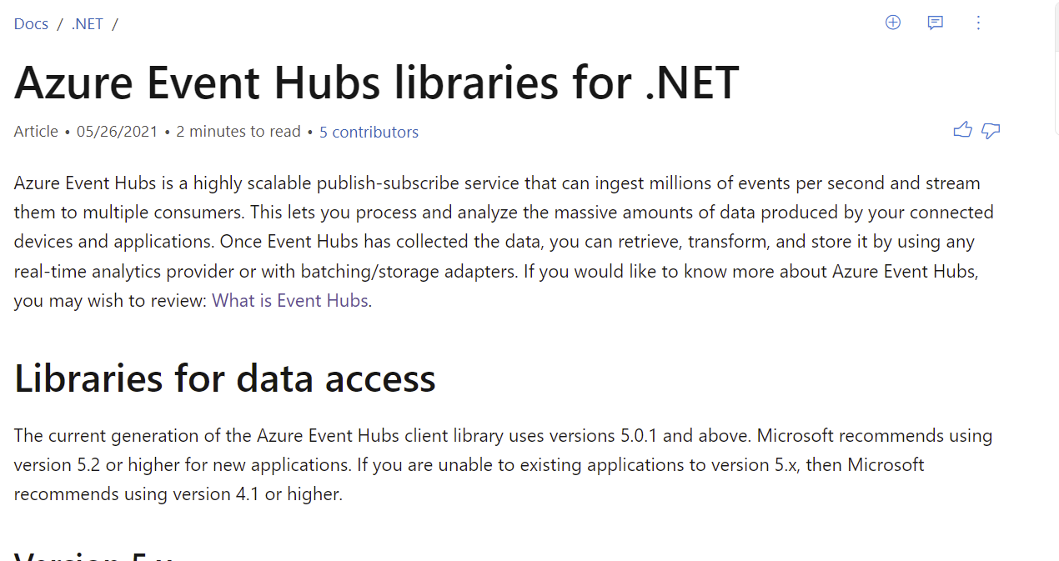
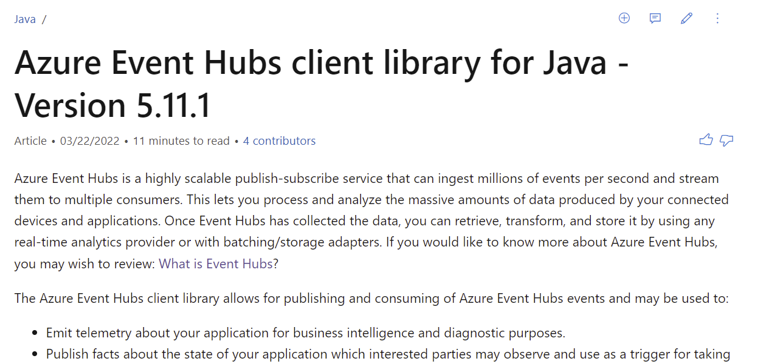
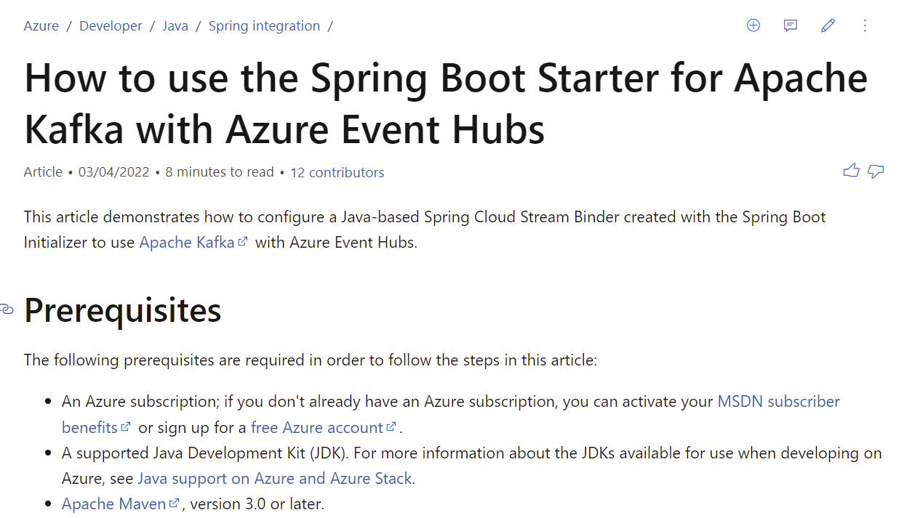
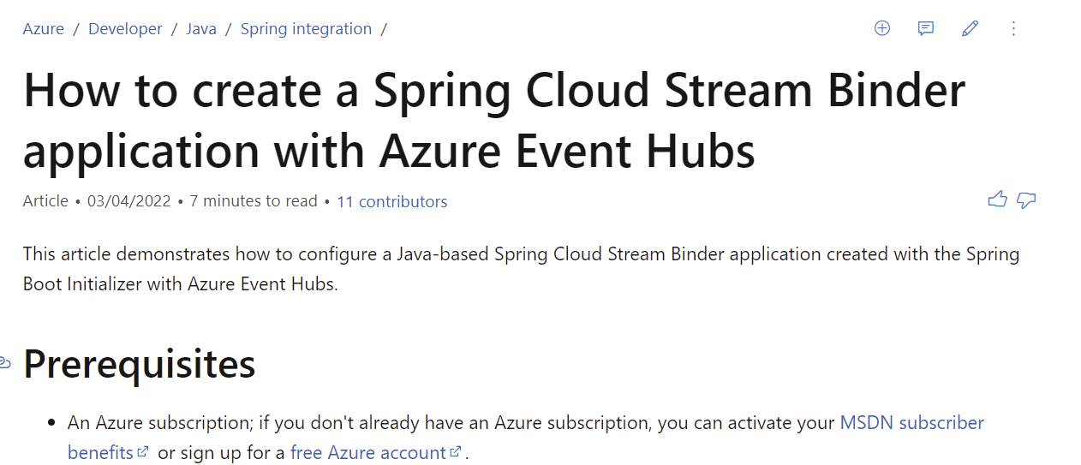
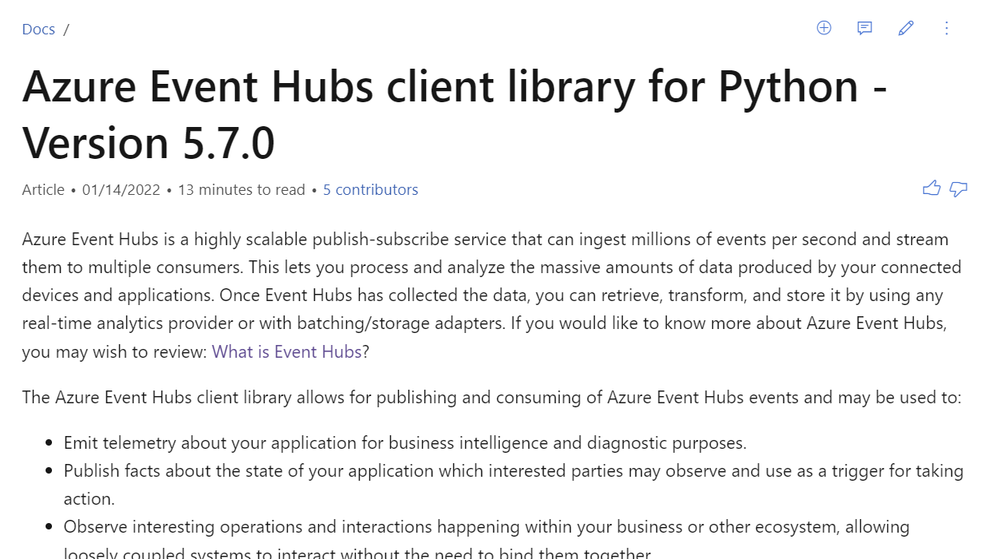
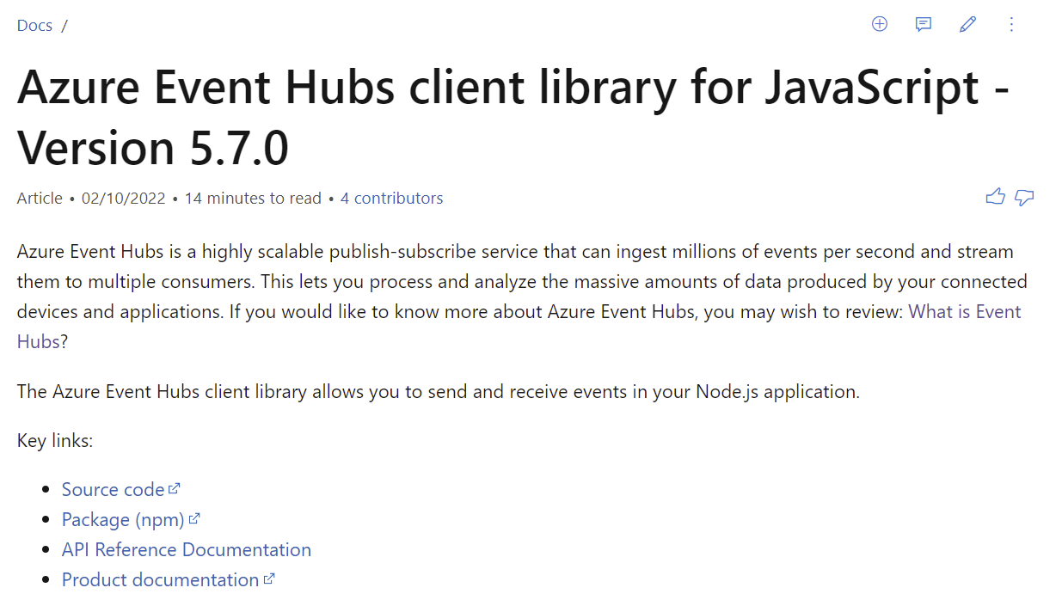
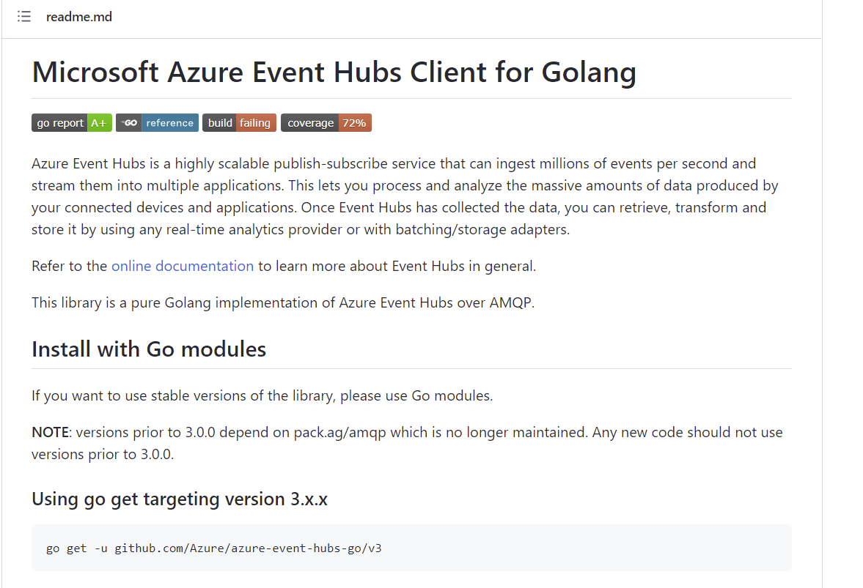
Event Hubs SDK Support: Azure SDKs
.NET
Java
Java Spring Boot
Python
JavaScript/Typescript
Go

Slide 15
Compatible Generic AMQP 1.0 Clients
Client Stack | URL
Apache Qpid Proton-C (Go, Python, Ruby, C++) | https://qpid.apache.org/proton/
Apache Qpid Messaging API | https://qpid.apache.org/components/messaging-api
Apache Qpid Proton-J | https://qpid.apache.org/proton/
Apache NMS AMQP | https://activemq.apache.org/components/nms/providers/amqp/
AMQP .NET Lite (all variants of .NET, incl. Nano & Micro) | https://github.com/Azure/amqpnetlite
Azure AMQP (our own server stack) | https://github.com/Azure/azure-amqp
Azure uAMQP C (Python, PHP) | https://github.com/Azure/azure-uamqp-c https://github.com/Azure/azure-uamqp-python
Rhea (NodeJS) | https://github.com/amqp/rhea
Go AMQP | https://github.com/Azure/go-amqp
Vert.X AMQP Client | https://vertx.io/docs/vertx-amqp-client/java/

Slide 16
Architecture
Azure Event Hubs Deep Dive
Internal Architecture
Protocols
Performance Metrics

Slide 17
Logical Architecture
Azure Portal
3-tier architecture: Networking, Messaging, Storage
Azure Resource Management API
AMQP 1.0
Apache Kafka RPC
HTTPS / WebSockets
Connection Management
IP Filtering, VNET/PEP
Transport Level Security (TLS)
Authorization Handling
Entity Management
HTTPS / WebSocket Protocol
AMQP 1.0 Protocol
Apache Kafka Protocol
Azure Active Directory
Gateway
AMQP
Partition Placement
Volatile State Replication
Sequencing & Timestamping
Journal Cache
Indexing
Pending request tracking
Checkpoint handling
At-Rest Encryption (CMK)
EH Capture
Premium Units (PU) buy isolated capacity at this layer
Backend (Broker)
(RPC)
HTTPS
Binary Log Data Store
Index Store
At-Rest Data Replication
Storage

Slide 18
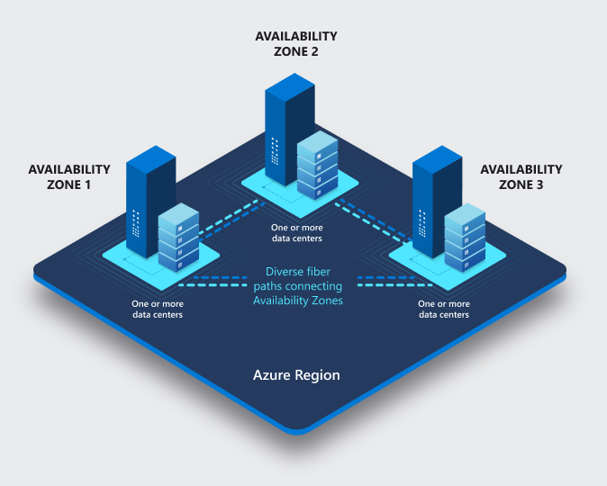
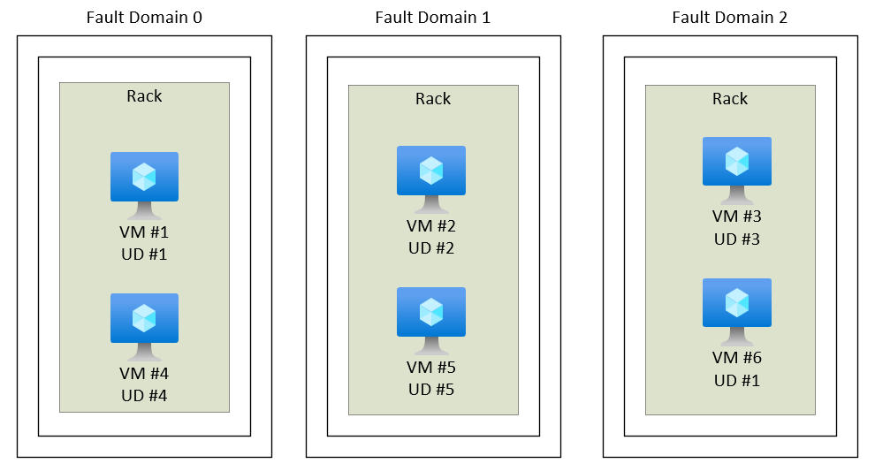
Fault Domains & Availability Zones
High-Availability starts at the physical reality
Fault Domain Placement: Cluster VMs are spread across at least 3 fault domains such that the loss of a rack or network poses no availability risk. Recovery from a fault domain failure is fully automated and the system maintains SLA.
Availability Zones Placement: Each cluster spans three availability zones and maintains SLA without any tolerance for data loss when one or two zones fail.

Slide 19
Backend and Gateway Clusters
Logical Architecture meets Placement
Process Container
Process Container
Process Container
Process Container
Process Container
Process Container
Process Container
Process Container
Process Container
Process Container
Process Container
Process Container
Process Container
Availability Zone 2
Availability Zone 3
Azure Service Fabric (SF) – Leader election (who owns what?), leader lookup, process placement and activation
Availability Zone 1
Fault Domain 1
Fault Domain 2
Fault Domain 3
Fault Domain 1
Fault Domain 2
Fault Domain 3
Fault Domain 1
Fault Domain 2
Fault Domain 3
VM1
VM3
VM5
VM7
VM9
VM11
VM13
VM15
VM17
VM2
VM4
VM6
VM8
VM10
VM12
VM14
VM16
VM18
Azure Virtual Machine Scale Sets (VMSS) – VM Placement/Deployment & Networking (SLB)

Slide 20
Backend and Gateway Clusters
Principles
Everything is automated. There's no manual intervention in placement of VMs or processes or workloads.
Each cluster has a well-known number of virtual machines. We don't use auto-scaling with VMs. We may (rarely) choose to initiate scale up/down to a different level.
Process placement and servicing/upgrade cycles are controlled by Azure Service Fabric.
Allocation of namespaces to clusters are based on well-established heuristics (Standard) or deterministic capacity limits (Premium). Customer-defined allocation in Dedicated.

Slide 21
Gateway and Backend
Azure Portal
Workload placement
Apache Kafka clients only see one broker that owns all partitions. Partition ownership is abstracted.
Azure Resource Management API
AMQP 1.0
Apache Kafka
HTTPS / WebSockets
Gateway
Azure Active Directory
Process Container
Process Container
Process Container
Process Container
Process Container
Process Container
Process Container
AuthZ delegated to AAD
Service Fabric Placement – Stateless Gateway Processes
VM1
VM3
VM5
VM7
VM9
VM11
VM13
VM15
VM17
AMQP
Entities are managed by the gateway layer
Workload placement in the gateway is done by the load balancer (quasi randomly) and accumulated state is managed for the duration of the link lifetime.
The gateway looks up the backend owner of an entity from SF for routing.
P
P
Backend
Process Container
Process Container
Process Container
Process Container
Process Container
Process Container
Process Container
Service Fabric Placement – Stateful Backend Processes
VM2
VM4
VM6
VM8
VM10
VM12
VM14
VM16
VM18
Workload placement in the backend is done by SF leader election, choosing a primary and designated secondary processes for owning a partition. Any required failover from primary to secondary is instant and automatic. Idle entities are unloaded.

Slide 22
Backend: Event Hubs Premium.
Partition ownership is dynamically mapped to the process(es) associated with a namespace via SF
Workload placement
Namespace PU are split across processes: 1 PU = 2 Proc (8GB Mem), 1 Core/Proc (2C)
2 PU = 2 Proc, 1 Core/Proc + 1 Core (3C)
4 PU = 2 Proc, 2 Core/Proc + 1 Core (5C)
8 PU = 4 Proc, 2 Core/Proc + 1 Core (9C)
16 PU = 4 Proc, 4 Core/Proc + 1 Core (17C)
Host 2
Namespace Broker Process 2 (4PU)
P
P
P
P
P
P
P
P
Host 1
Namespace Broker Process 1 (4PU)
P
P
P
P
P
P
P
P
Cores are exclusively mapped to a broker process. >=2PU: 1 Core extra for utility tasks.
CPU Cores L-Series
Memory Allocations
1
2
8GB
VM6
CPU Cores L-Series
Memory Allocations
1
2
+
8GB
Isolated VMs / L88is
VM6
Designated secondaries in different fault domains and AZ reserved for failover
Backend
Process Container
Process Container
Process Container
Process Container
Process Container
Process Container
Process Container
Service Fabric Placement – Stateful Backend Processes
VM2
VM4
VM6
VM8
VM10
VM12
VM14
VM16
VM18

Slide 23
Storage Layer – Event Hubs Standard
P
P
Backend
Process Container
Process Container
Process Container
Process Container
Process Container
Process Container
Process Container
Service Fabric Placement – Stateful Backend Processes
VM2
VM4
VM6
VM8
VM10
VM12
VM14
VM16
VM18
Events are written to append blobs ("extents"). All writes are synchronously triple replicated across availability zones.
Extents are sealed after hitting a size threshold.
Expiry removes extents.
Normalizing / Indexing
Each Event Hub Cluster uses numerous storage accounts to spread the load and overcome storage quota limitations.
Partition storage is allocated to those storage accounts.
Batching
Index
At-Rest Encryption (CMK)
Azure Storage Provider
Storage Account 1 (ZRS)
Stg Acc 2
Stg Acc N
Sealed
Sealed
Active Writes
Extent 1
Extent 2
Extent 3
Partition X Log
B
K
E
T
V
A

Slide 24
Storage Layer – Event Hubs Premium
P
P
Backend
Process Container
Process Container
Process Container
Process Container
Process Container
Process Container
Process Container
Service Fabric Placement – Stateful Backend Processes
Normalizing / Indexing
VM2
VM4
VM6
VM8
VM10
VM12
VM14
VM16
VM18
Batching
Index
Synchronous 3x availability zone replication with flush to disk for each write: Consistently under 3ms.
At-Rest Encryption (CMK)
Block Store Provider
NVMe
NVMe
NVMe
NVMe
NVMe
NVMe
NVMe
rpc
B
B
B
Local Block Store
Process Container
Process Container
Process Container
Process Container
Process Container
Process Container
Process Container
Service Fabric Placement – Stateful Backend Processes
VM2
VM4
VM6
VM8
VM10
VM12
VM14
VM16
VM18
Block store is a fast NVMe based append log store. Native code, Service Fabric Replication.
As with EH Std, Partitions are mapped to accounts.
But only complete extents are written to storage at once.
Storage Account 1 (ZRS)
Stg Acc 2
Stg Acc N
Sealed
Sealed
Active Writes
Extent 1
Extent 2
Extent 1
Extent 2
Extent 3
Partition X Log
B
K
E
T
V
A
Partition X Log

Slide 25
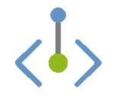
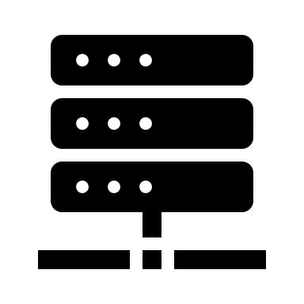
Networking Features
Firewall, Virtual Network Integration with Private Endpoints
Each cluster has a single public load-balancer IPv4 address. The address is generally stable and will very rarely change. But: use DNS firewall rules on your namespace.
AMQP 1.0 w/ TLS
Apache Kafka RPC
HTTPS / WebSockets
CNAME clemensvams.servicebus.windows.net
Namespace names alias the cluster DNS name. EH relies on that hostname to identify the namespace tenant and it can therefore not be further aliased.
Client-Side Firewalls & Proxies
WebSockets AMQP tunneling allows port 443 firewall traversal.
Customer Virtual Network: 10.0.0.0/8
Subnet 1: 10.1.1.0/24
Gateway
ns-eh1-prod-am3-403.cloudapp.net
52.236.186.64
Private Endpoint 10.1.1.42
VM 10.1.1.28
IPv6 SE
TLS 1.2 is the default. All current, supported clients use TLS 1.2 and all traffic generally uses TLS. Legacy clients are still permitted to use TLS <1.2, customer controlled. TLS is terminated at the gateway VMs.
Each cluster has an Azure-private "IPv6 Service Endpoint" address for private endpoints.
Common, namespace-level IP filter and VNet/PEP firewall policy enforcement on each VM.
VM1
VM3
VM5
VM7
VM9
VM11
VM13
VM15
VM17

Slide 26
Networking Features
Event Hubs namespaces can be attached to one or more virtual networks and the public IP address space concurrently and act as safe "Layer 7" stream bridges.
Customer Virtual Network: 10.1.0.0/16
Subnet 1: 10.1.1.0/24
Public Network
Event Hubs Namespace
Customer NAT
Private Endpoint 10.1.1.42
VM 10.1.1.28
Filter
Topic
Client 192.168.1.2
Filter
Customer Virtual Network: 10.2.0.0/16
Subnet 1: 10.2.1.0/24
Private Endpoint 10.2.1.23
VM 10.2.1.56

Slide 27
Authorization
Azure Active Directory RBAC and Shared Access Signatures (SAS)
Event Hubs has two authorization models.
SAS (Local): Simple model for external clients that cannot use Azure Active Directory for any reason.
Very simple. Rights at namespace or entity scope: "Send", "Listen" (Receive/Subscribe), "Manage"
No accounts. 12 named rules per scope, each rule has a key. Rules combine a set of rights.
HMACSHA256 signed tokens are issued using name and key and passed to the service.
Tokens can be issued in the client or by some security token service holding the key
Can be turned off via the portal on the overview page under "Local Authentication"
AAD RBAC: Integrated Azure identity model, also for service-level integration (managed identity)
Very detailed, operation-level permission set that can be assigned to roles
Several standard control- and data-plane roles (like Data Owner, Data Sender, Data Receiver)
Roles can be assigned at the namespace and entity level

Slide 28
Authorization
Allows very fine grained control with tokens scoped to a certain time and/or EH and/or publisher policy
Azure Active Directory RBAC and Shared Access Signatures (SAS)
A
B
Client
Client
SAS Token
Custom Token Service
Identity Token
1
Rule / Key
Rule / Key
AAD
Identity (SSO)
2
Service Access
3
AuthZ Policy Engine
SAS policy check is performed against the namespace and entity rule set and verifies the token with the stored signing key for the rule.
Service Access Token
AMQP 1.0
4
AMQP 1.0
HTTPS / WebSockets
HTTPS / WebSockets
Event Hubs Gateway
Event Hubs Gateway
Permissions Cache
Entity policies

Slide 29
Replication & Federation
Event Hubs Premium

Slide 30
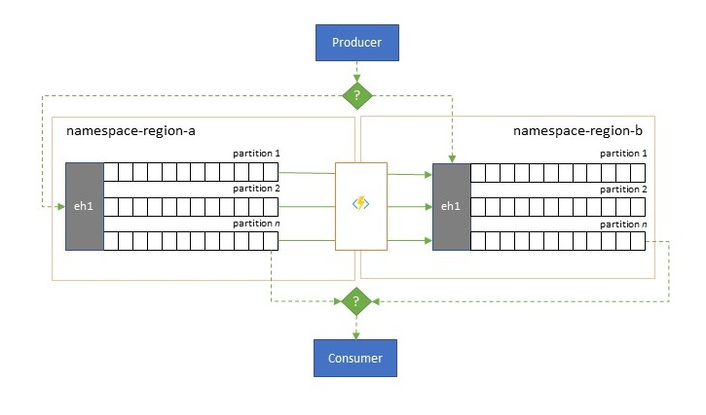
Replication Tasks
Problem
Providing code-free replication of data between Service Bus and Event Hubs
In many scenarios, event data needs to be moved or merged across regions.
Solution
Quick and simple replication between namespaces through templates available on Azure Portal’s Tasks.

Slide 31

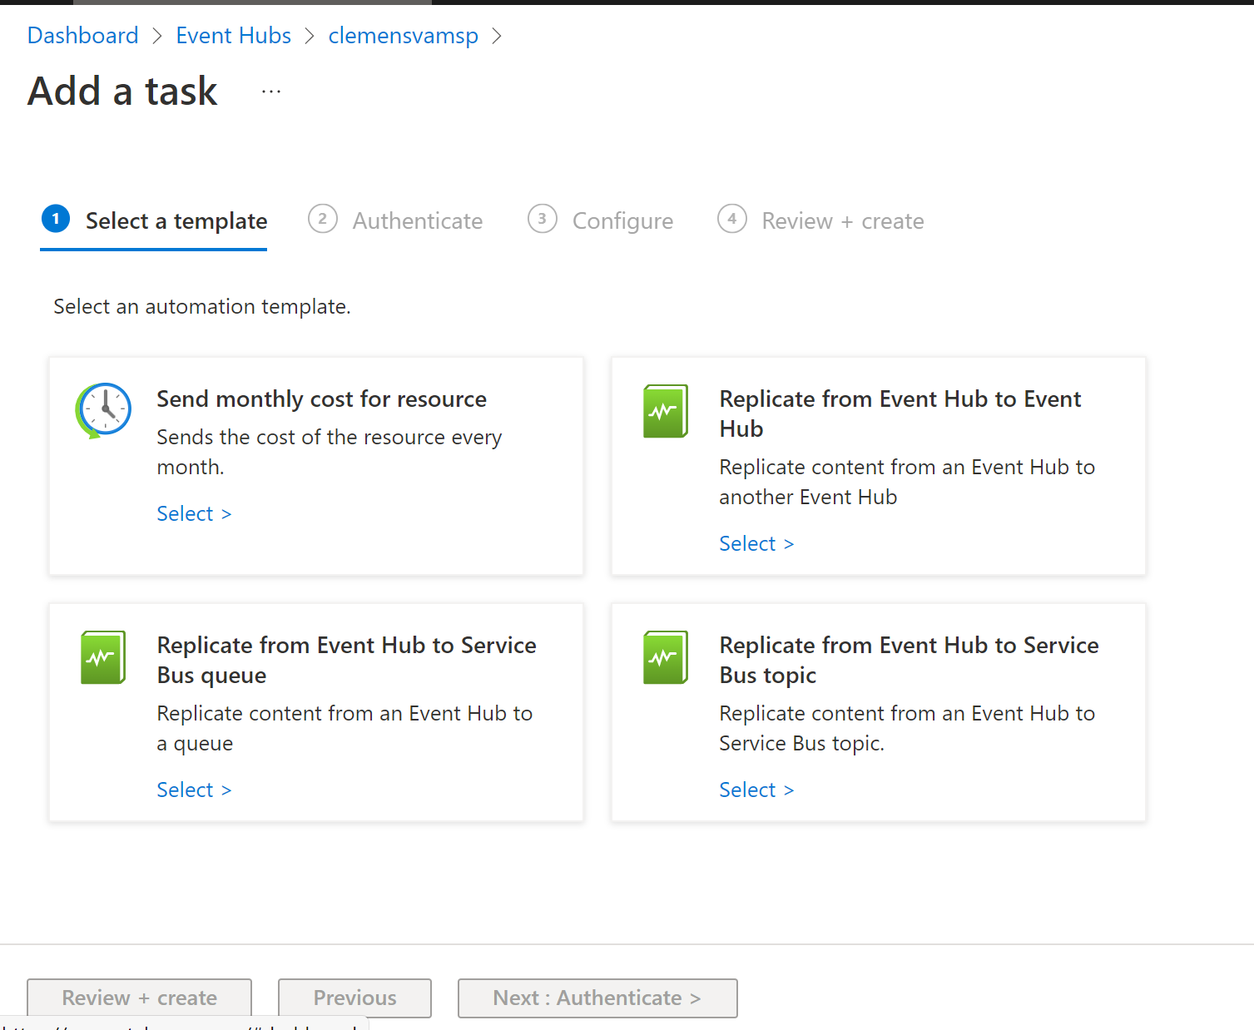

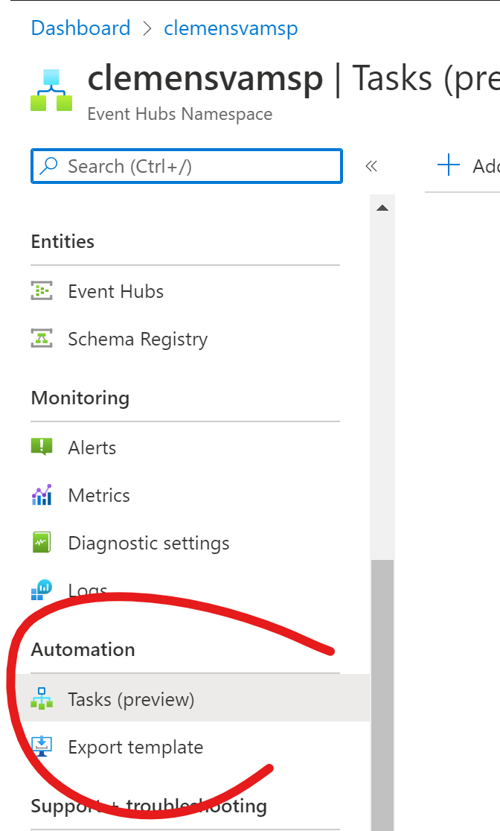


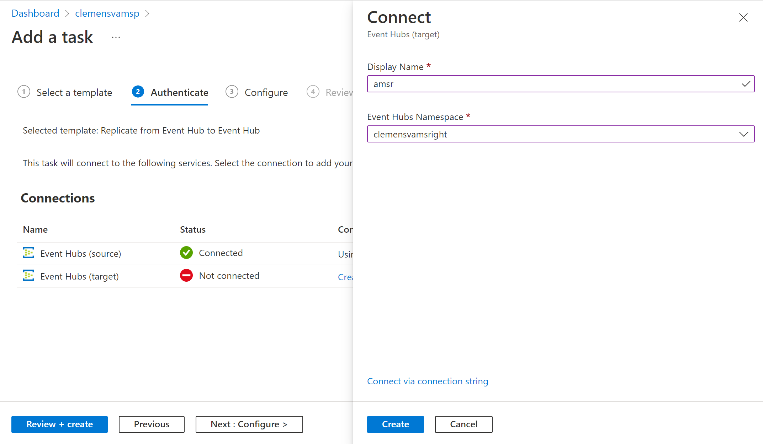
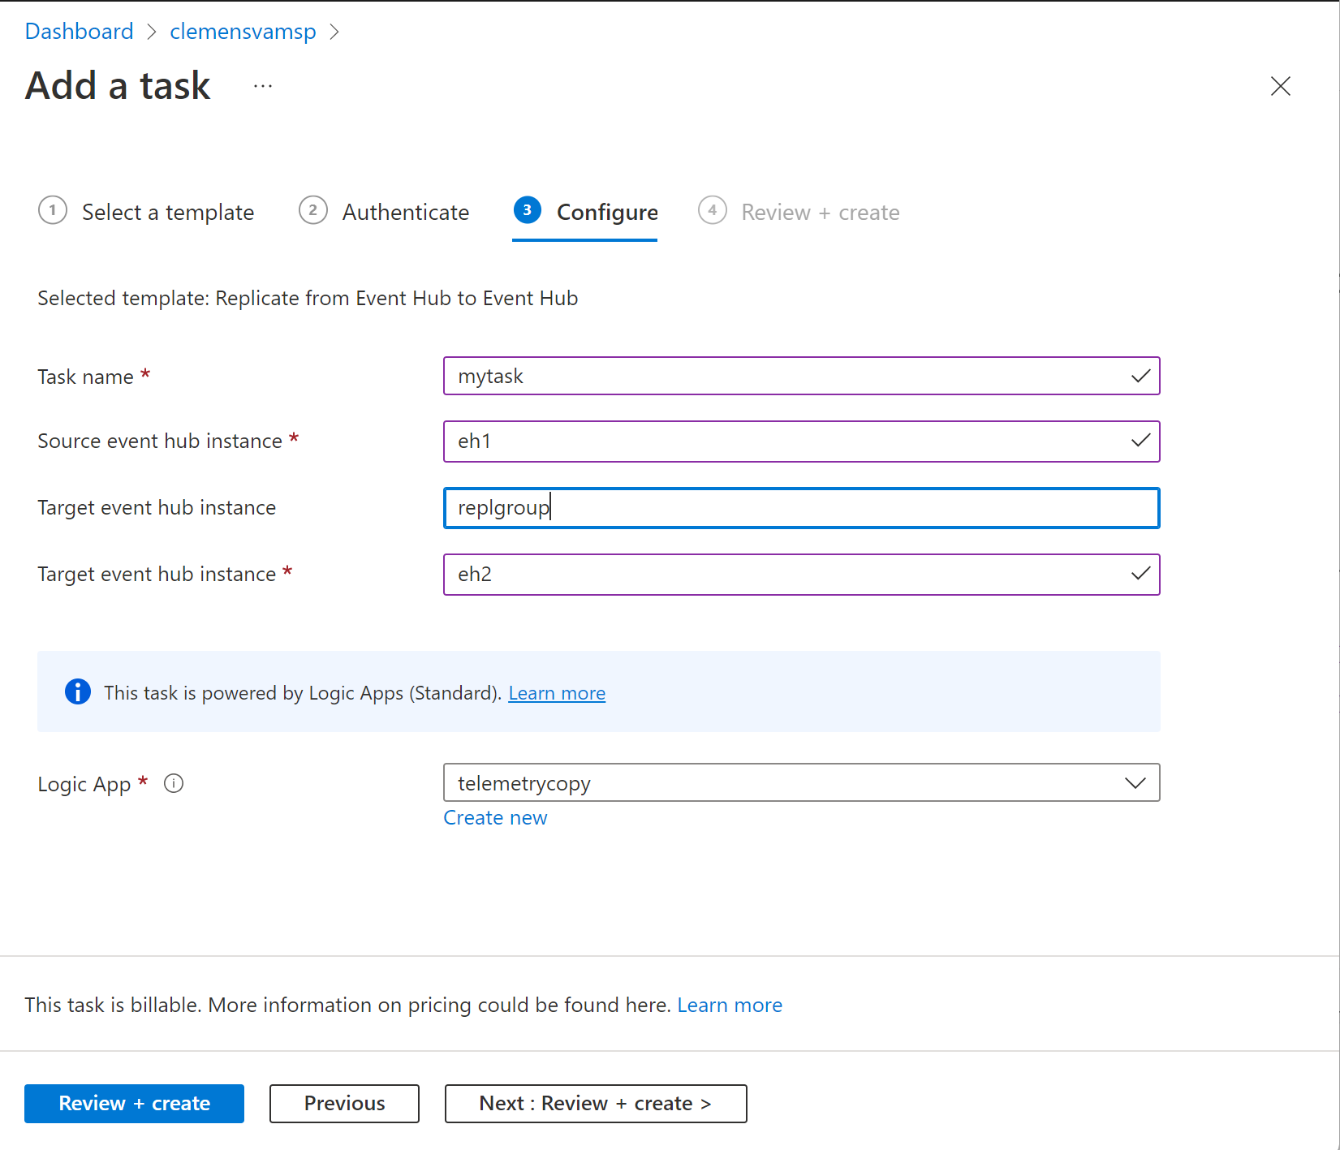
Automation Tasks to the rescue
Select template
Create
Establish connection
No-code, no-designer replication backed by Logic Apps (Standard)
Review
Configure

Slide 32
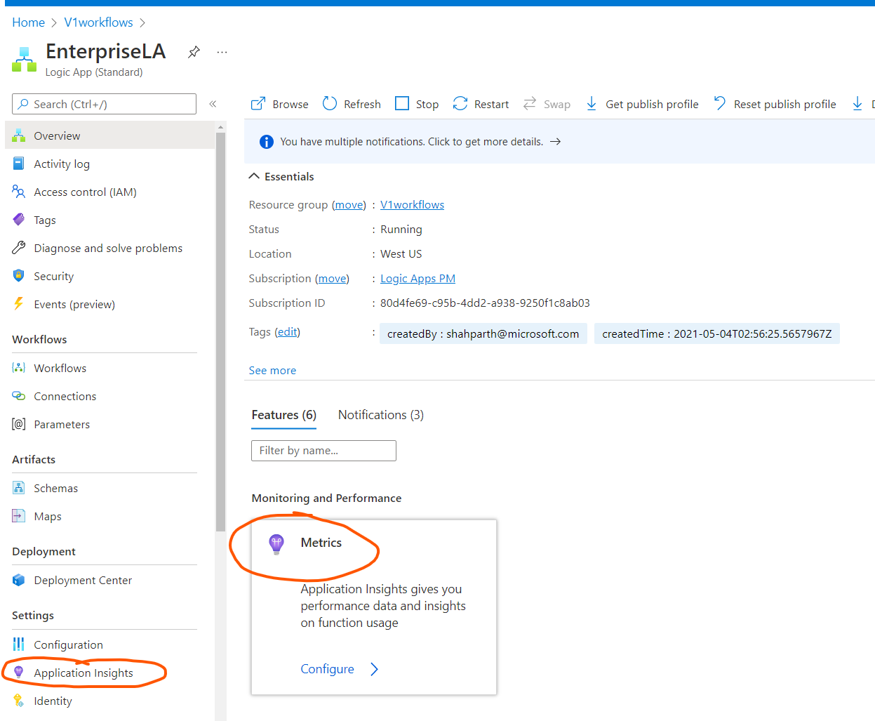
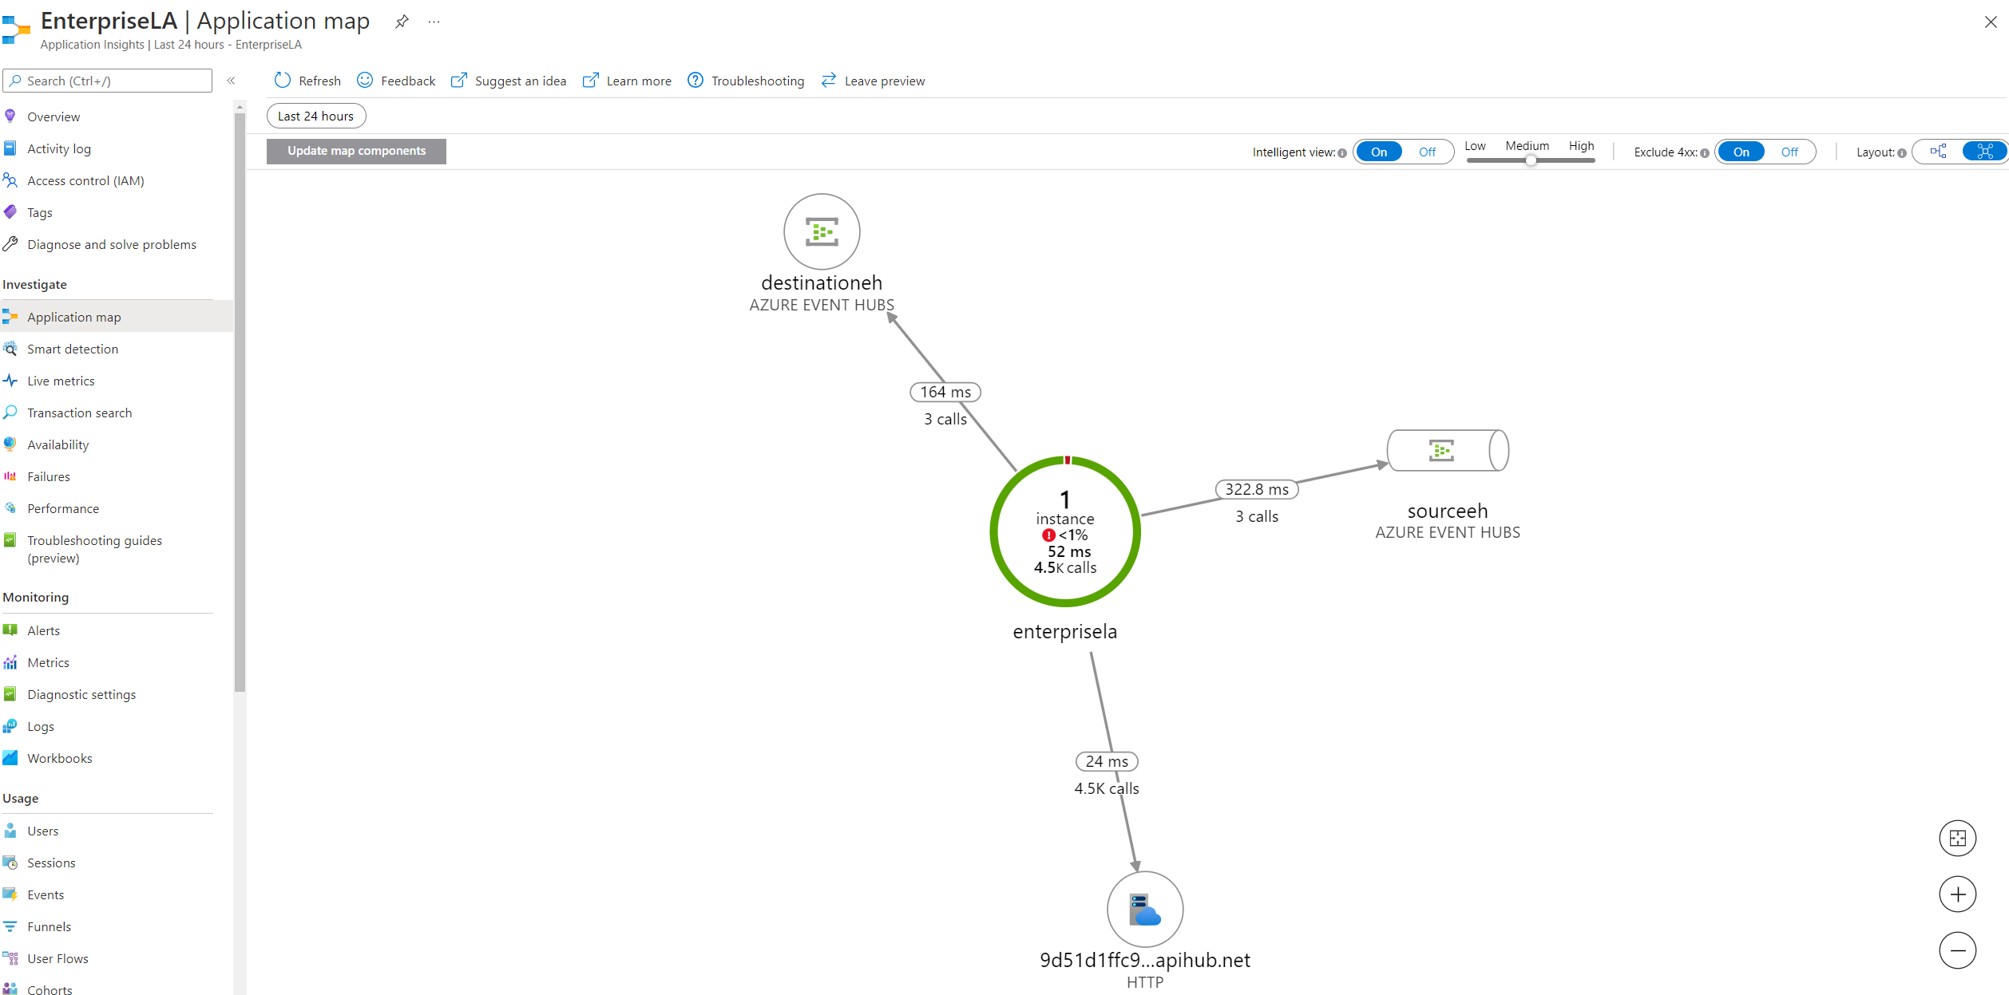
EventHub replication visualization

Slide 33
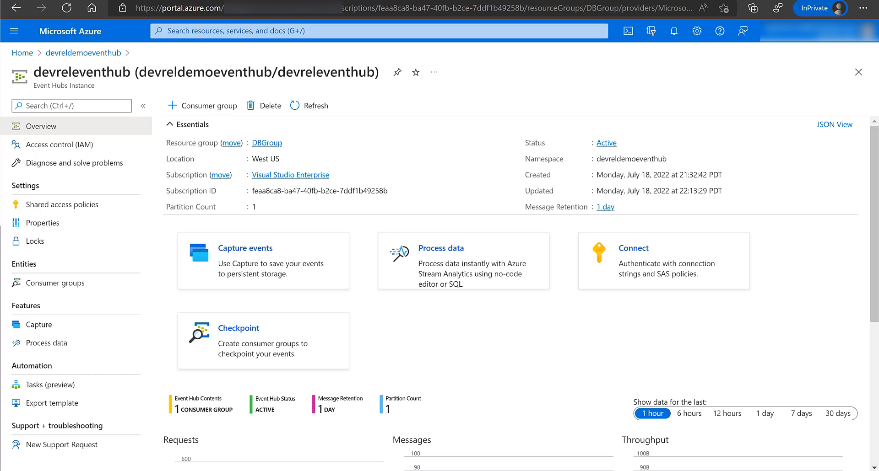

Slide 34
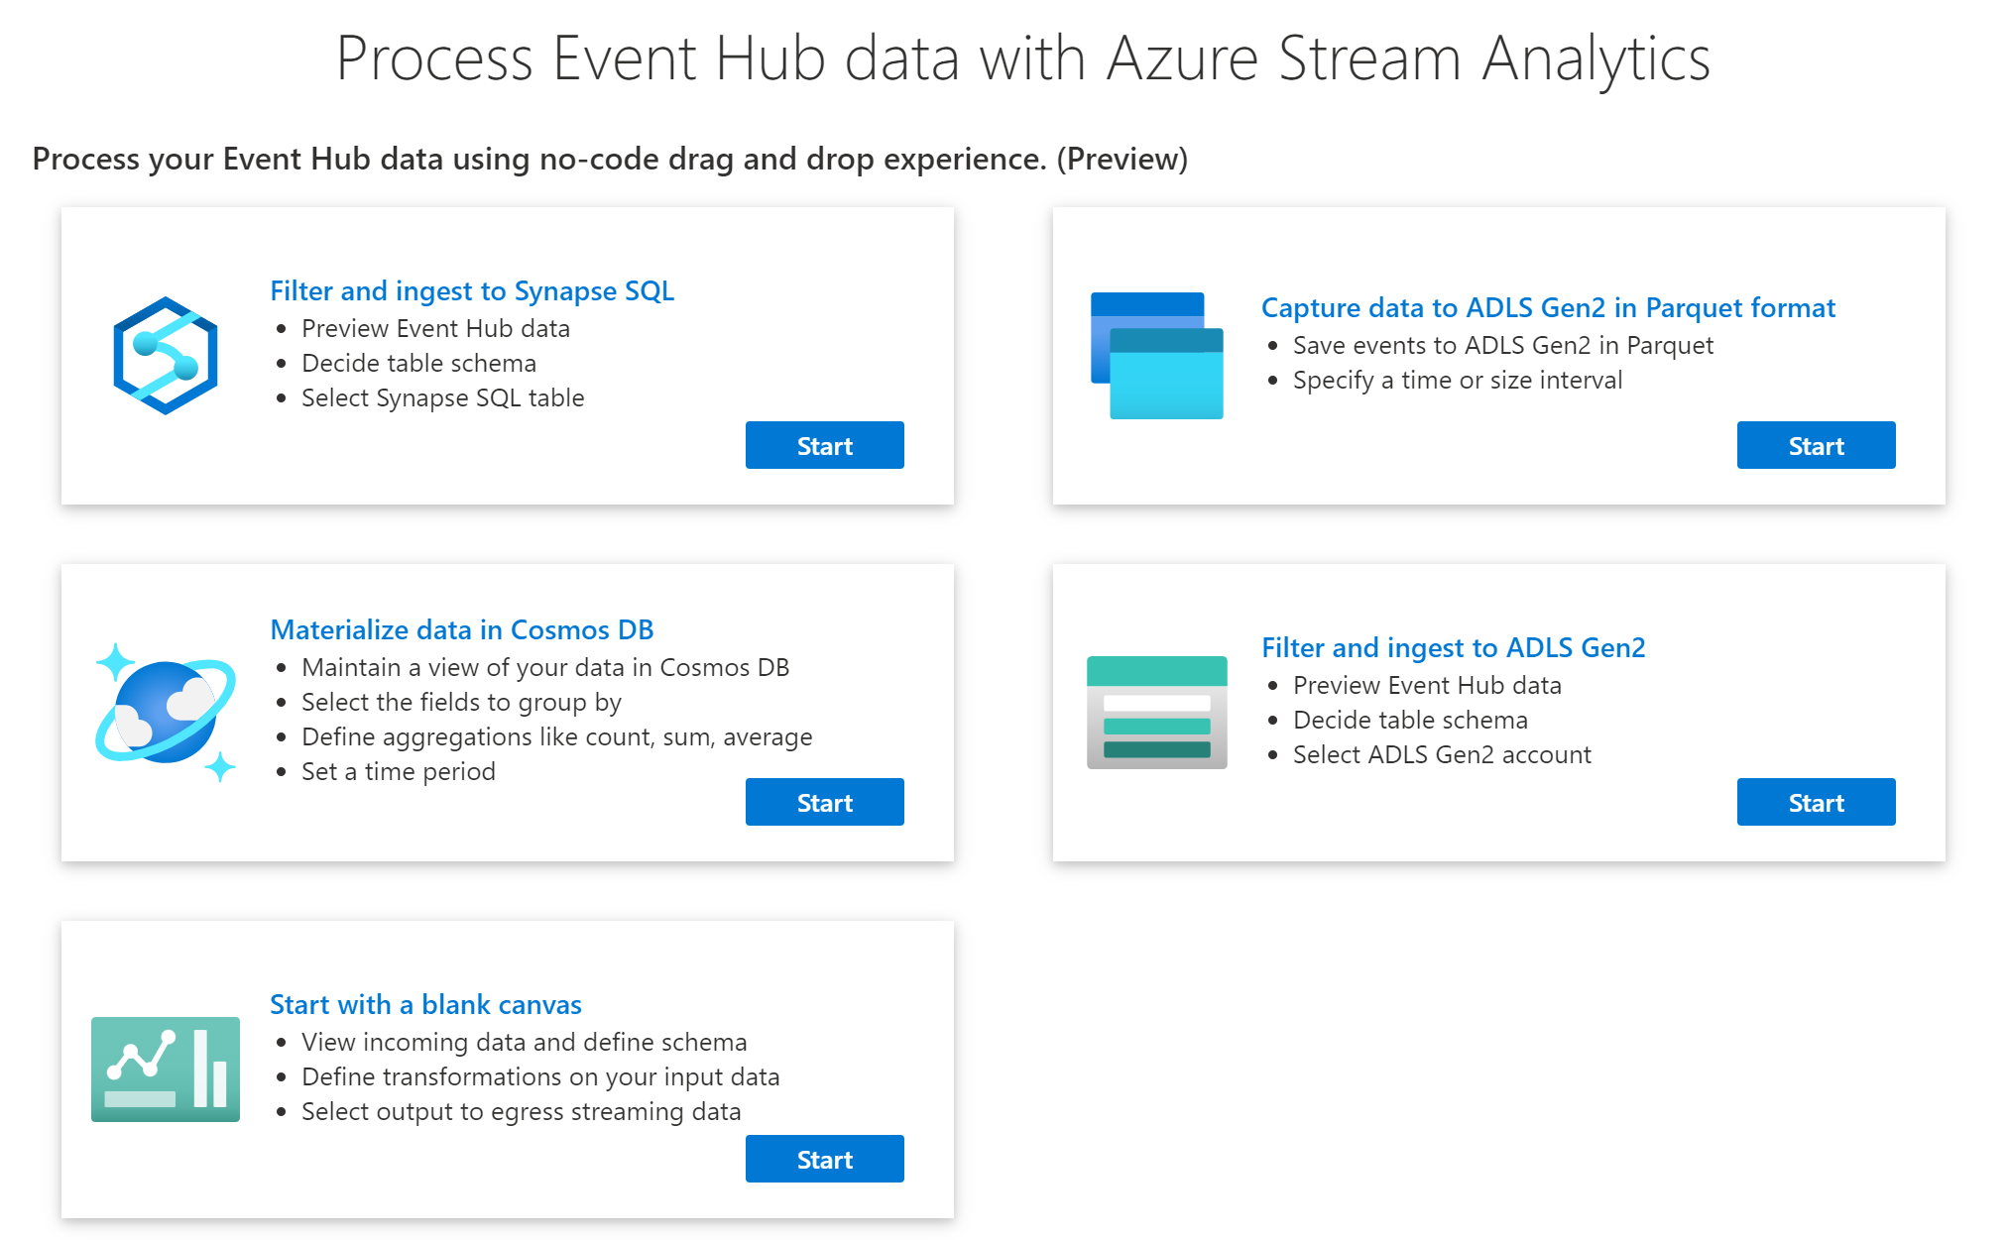

Slide 35
Performance!
Event Hubs Premium

Slide 36
Event Hubs Premium is Fast!
Event Hubs Premium end-to-end latency < 10ms for most Event Streaming workloads.
Performance Metric | Expected Range | Comments
Throughput | ~5-10 MB/s per 1 PU | Maximum throughput can be achieved by scaling partitions For both Kafka and AMQP
Latency | <10 ms | With 1 MB/s load, 4 PU namespace For both Kafka and AMQP

Slide 37
Event Hubs Premium – Predictability
Event Hubs Premium offers consistent end-to-end latency of < 10ms.

Slide 38
Effective Global Reliability
Uptime – Is the cluster available to accept connections?
100%
Reliability – Are individual operations suceeding?
>99,9999% weekly average

Slide 39
Azure Event Hubs
Platform-as-a-Service Event Stream Broker
Use the Apache Kafka® API, but with far lower cost and better performance.
Fully managed: You use the features, Azure deals with everything else
AMQP 1.0 standards compliant, Apache Kafka® wire-compatible
Polyglot Azure SDK and cross-platform client support
Industry-leading reliability and availability
Fast.

Slide 40
Thank You!

Slide 41
Q&A
That was a lot, wasn't it?

